Slide 1

How to get full points on your text
4B SA Writing Task
2 Example Texts

Slide 2
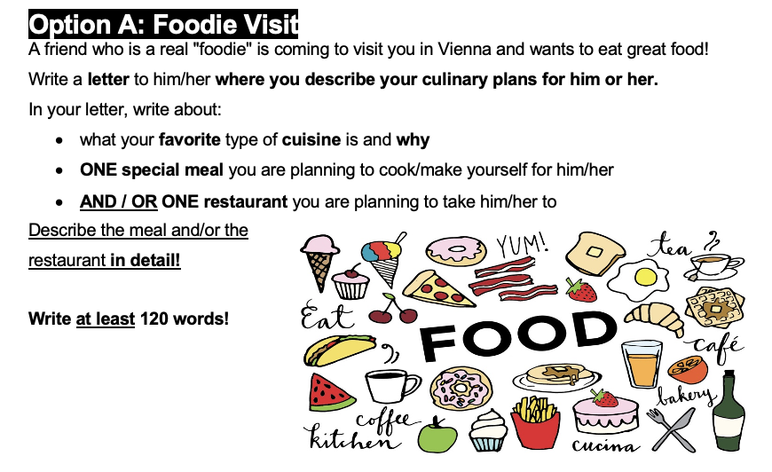

Slide 3
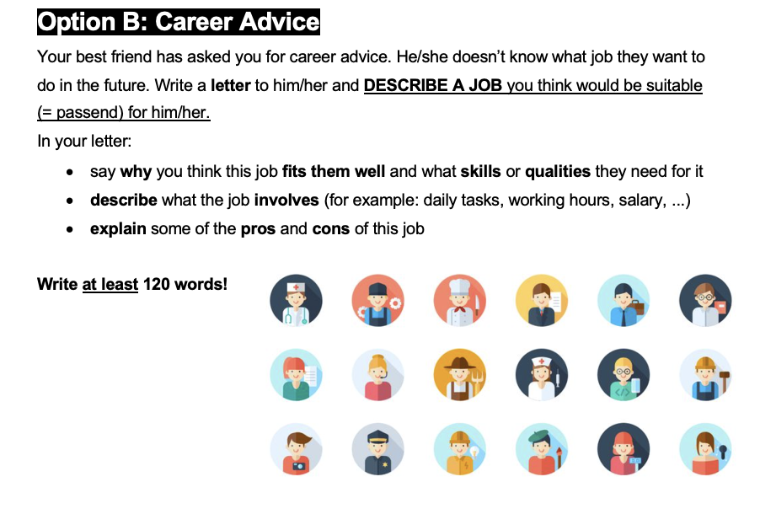

Slide 4
The categories we analyze for each text
LANGUAGE FACTORS
TASK ACHIEVEMENT
Advanced vocabulary
Favourite cuisine / Why job fits
Great descriptions and details
Meal you cook or eat / What the job involves
Restaurant details / Pros and cons of the job

Slide 5

MODEL TEXT
Student A
01
Option A:
Foodie Visit

Slide 6
Student A: Opening
Setting the scene with personal connection
RESTAURANT
STUDENT TEXT
Dear Marianna,
MEAL
You texted me and told me you're arriving in Vienna tomorrow, so I wanted to recommend a restaurant to you since I know how you love food. I will also cook for you, so you don't have to eat take out.
PERSONAL TOUCH

Slide 7
Student A: Cuisine + Homemade Meal
Two bullet points covered in one natural paragraph
FAVOURITE CUISINE ✓
STUDENT TEXT
MEAL DETAILS ✓
My favourite cuisine is Japanese cuisine, so I've learnt how to make sushi and I'm sure you'll like it. I usually make it with some salmon and some cucumbers, but since you hate cucumbers, I'll replace them with some cream cheese.
PERSONAL DETAIL

Slide 8
Student A: Restaurant Introduction
Setting up the detailed description
RESTAURANT ✓
STUDENT TEXT
ATMOSPHERE
You told me you wanted to visit a nice restaurant, so I found one. It's called 808 and it's located near the city center. It's a beautiful and cozy restaurant. My favourite dish there is their truffle pasta.
VOCABULARY

Slide 9
Student A
Vivid, sensory details
SENSORY DETAILS
STUDENT TEXT
ADVANCED VOCABULARY
It's full of flavour, hot and the preparation is definitely worth watching. The waiter brings the boiled pasta right to your table and throws it into a huge parmesan wheel. He adds a tiny bit of alcohol and a blue fire starts. He mixes it with the melting cheese right in front of you and grates some black truffles on top of it.
RESTAURANT DETAIL ✓✓

Slide 10
Student A: Strong Finish
VIVID EXPRESSION
STUDENT TEXT
The flavour is incredible. The tenderness of the pasta and the flavour of the truffles will make your taste buds go crazy. It's also really filling and not fattening at all. I'm definitely taking you to that place!
VOCABULARY
PRACTICAL INFO
Best regards,
Student A

